Slide 1
CSC312
Automata Theory
Lecture # 12
Chapter # 7 by Cohen
Kleene’s Theorem

Slide 2
Proof of Part-3
Converting REs into FAs.
Statement:
If a language can be expressed by a RE then there exists an FA accepting the language.
We know that every RE can be build up from the letters of the alphabet Σ and Λ by repeated application of certain rules, addition, concatenation, and closure. All these methods of constructing REs can be explained by defining the following rules

Slide 3
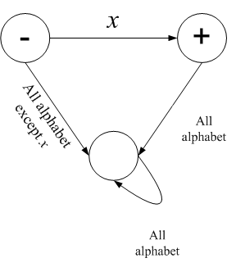
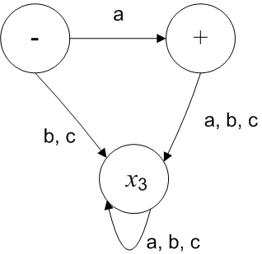
Proof of Part-3 (Cont…)
Rule 1: There is an FA that accepts any particular letter of the alphabet.
There is an FA that accepts only the word Λ.
If x is in Σ, then the FA
e.g. if Σ= {a, b, c}
accepts only the word x

Slide 4
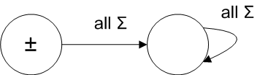
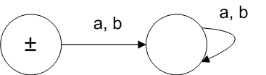
Proof of Part-3 (Cont…)
One FA that accepts only the word Λ is
e.g. if Σ= {a, b}, then the DFA is

Slide 5
Proof of Part-3 (Cont…)
Rule 2: (Union of two FAs)
If there is an FA called FA₁ that accepts the language defined by the RE r₁ and there is an FA called FA₂ that accepts the language defined by RE r₂, then there is an FA that we shall call FA₃ that accepts the language defined by the RE (r₁+r₂).
Proof of Rule 2:
We prove rule 2 by showing how to construct the new machine from the two old machines i.e. we shall prove that FA₃ exists by showing how to construct it. (Exercise Q. No.3, P-143)

Slide 6
Union of FA’s
Let FA1 be an FA corresponding to RE r1, and FA2 be an FA corresponding to RE r2. Now let FA3 be an FA corresponding to RE (r1 + r2), then the initial state of FA3 must correspond to the initial states of FA1 and the initial state of FA2.
Similarly the final state of FA3 must correspond to a final state of FA1 or final state of FA2 or both.

Slide 7
Union of Fa’s (Cont.…)
In general, FA3 will be different from both FA1 and FA2, so the labels of the states of states of FA3 may be supposed to be Z1, Z2, Z3,…., where Z1 is supposed to be initial state.

